Slide 1

Making Tidy Data
Elizabeth Wickes, @elliewix
Data Curation Specialist
Research Data Service, University of Illinois
Notes:
10.5281/zenodo.161365

Slide 2
While I’m yakking
Download and install R
https://cran.mtu.edu/
Download Rstudio
https://www.rstudio.com/

Slide 3
Why do we care?
Because R does
Many of the headaches about R are with just trying to reshape the data into something that the functions are expecting.
But if you can start with this design from the beginning, you’ll save yourself some headaches.

Slide 4
Humans versus R
What you want to type
What R wants

Slide 5
Humans versus R
What will get your analysis done
What you want to type
What R wants

Slide 6
Playing with a spreadsheet
https://ndownloader.figshare.com/files/2252083
Open this file in your spreadsheet program of choice.
We’ve got several tables per sheet, formatted for readability

Slide 7
Try reformatting it
Pair up or work with 1-2 other people
Play around with the spreadsheet
Think about how you can reorganize this into a single sheet
Determine the new column headers
Make a new tab and start moving the data over
Green stickies up when done

Slide 8
Discussion
What did you discover about the spreadsheet?

Slide 9
Discussion
What was your strategy for reorganization?
What were the column headers that you selected?

Slide 10
Discussion
How would adding the 2014 data impact your design choices?

Slide 11
All snark aside
Setting up your data file to play nicely with what R expects will save you time and usually means that your format will flexible moving forward.
We’re going to explore what the tidy data format is in this workshop.

Slide 12
What is tidy data?
Wickham, Hadley. (August, 2014). “Tidy Data.” Journal of Statistical Software, 10(59).
Don’t describe data in terms of rows and columns.
Data consists of:
Variables
Observations
Values (at the intersection of variables and observations)

Slide 13
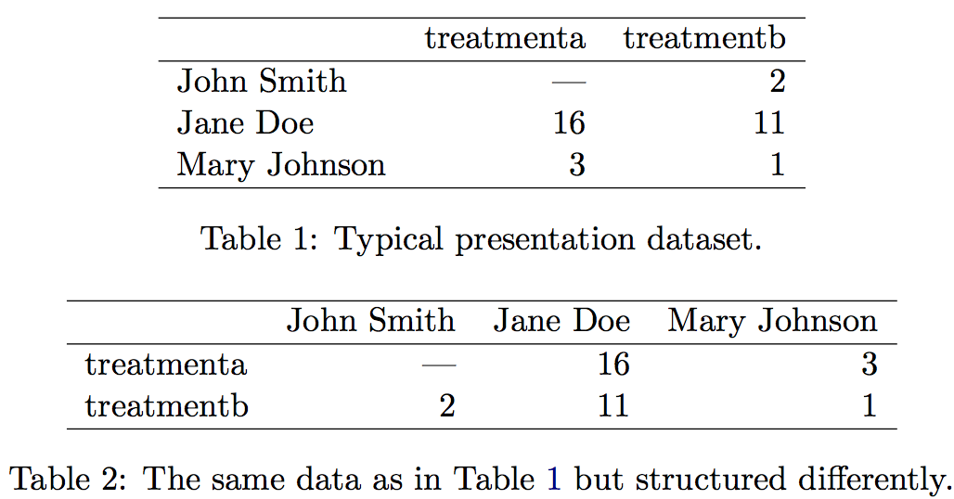
Semantic groups

Slide 14
Semantic groups
What are the nouns that we see?
Humans (names – text codes)
Treatments (text codes)
Results (numerical)
These are now our columns

Slide 15
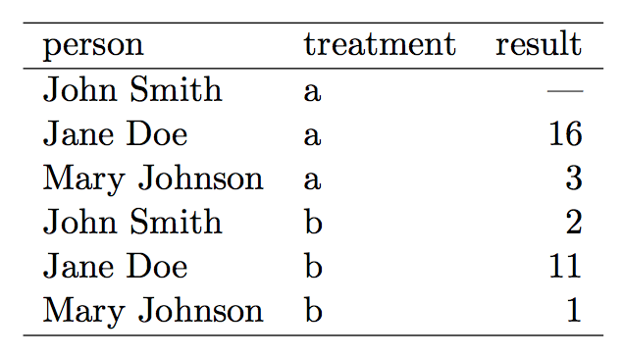
The tidy* version
Each variable forms a column
Each observation forms a row.
Each type of observational unit forms a table.

Slide 16
Why this feels like a database
This is Codd’s 3rd normal form (Codd 1990), but with the constraints framed in statistical language, and the focus put on a single dataset rather than the many connected datasets common in relational databases.

Slide 17
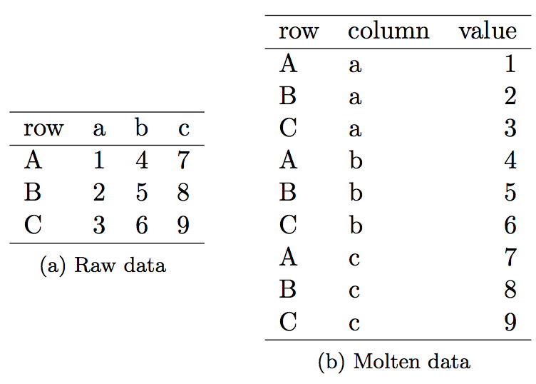
Melting data

Slide 18
But I just want to make a graph
Open up Rstudio
Live demo time
Load the data via Tools -> Import Dataset -> From Text File
Rstudio tour
Using plot(data) to get a quick impression
sapply(cleanedsurvey, summary) for quick descriptive statistics
install.packages(“ggplot2”) # see the quotes?
library(ggplot2) # see the lack of quotes?

Slide 19
But I just want to make a graph
ggplot2
External graphic package
Basic syntax:
ggplot2(tell it what the data is…) + otheroptions() …
These things layer together to make what you need
Don’t try to memorize these options, just find references you like
R syntax, particularly between packages, is ALL OVER THE PLACE. Don’t try, just copy/paste.

Slide 20
But I just want to make a graph
ggplot(data = cleanedsurvey) + geom_histogram(aes(x = Weight))
Make the ggplot object…
State the data.frame variable name
Use + to add graphic elements
Name of column where the data is that you want to plot
We want a histogram
“aesthetic mappings that describe how variables in the data are mapped to visual properties (aesthetics) of geoms.”

Slide 21
But I just want to make a graph
ggplot(data = cleanedsurvey) + geom_histogram(aes(x = Weight))
Your data frame goes here
Use + to add stuff
Name of column where the data is that you want to plot

Slide 22
The joy of tidy
Having a restricted number of columns keeps our own results and work tidier.
For example, just trying to get the average weight for all… we can just use mean(cleanedsurvey$Weight).
We don’t have to reshape, melt, or combine things.
We can also split the data apart in ways that make sense.
A little more like database queries.

Slide 23
Acknowledgments
Original data file from the spreadsheets lesson at Data Carpentry
http://www.datacarpentry.org/spreadsheet-ecology-lesson/
My R graphics reference was R for Everyone

